Slide 1
∠s formed by Chords & Tangents
Geometry
Mr. Bower
BowerPower.net

Slide 2
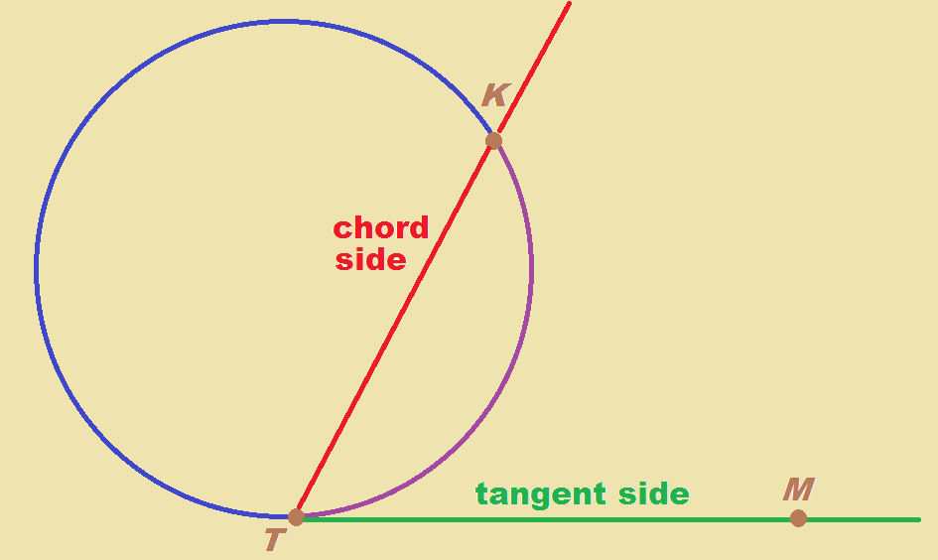
Angle w/chord side & tangent side

Slide 3
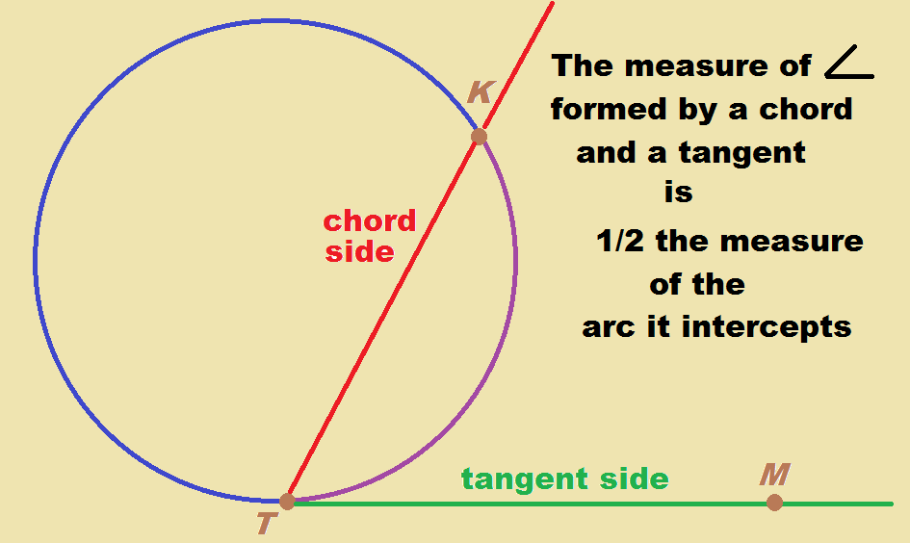
Angle w/chord side & tangent side

Slide 4
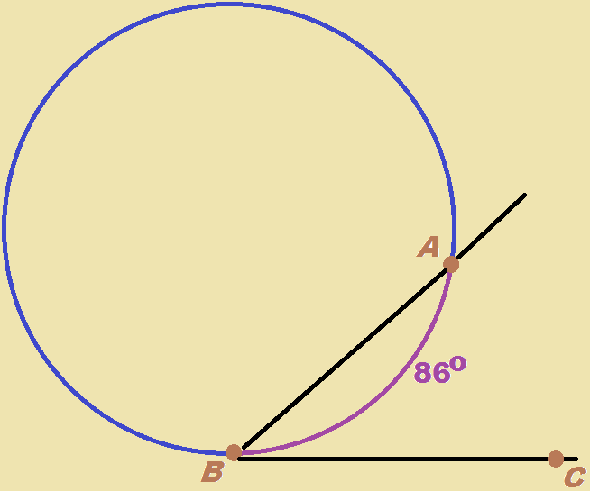

Example 3
What is $m∠ABC$ ?

Slide 5

Example 3
What is $m∠ABC$ ?
$43°$

Slide 6
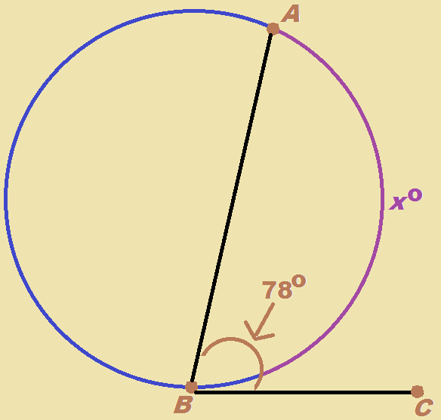

Example 4
What is $x$?

Slide 7

Example 4
What is $x$?
$x=156$

Slide 8
BowerPower.net

