Slide 1
Inscribed Angles
Geometry
Mr. Bower
BowerPower.net

Slide 2
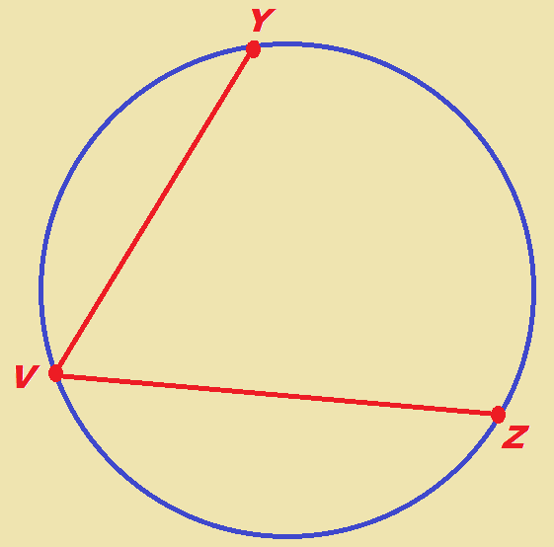
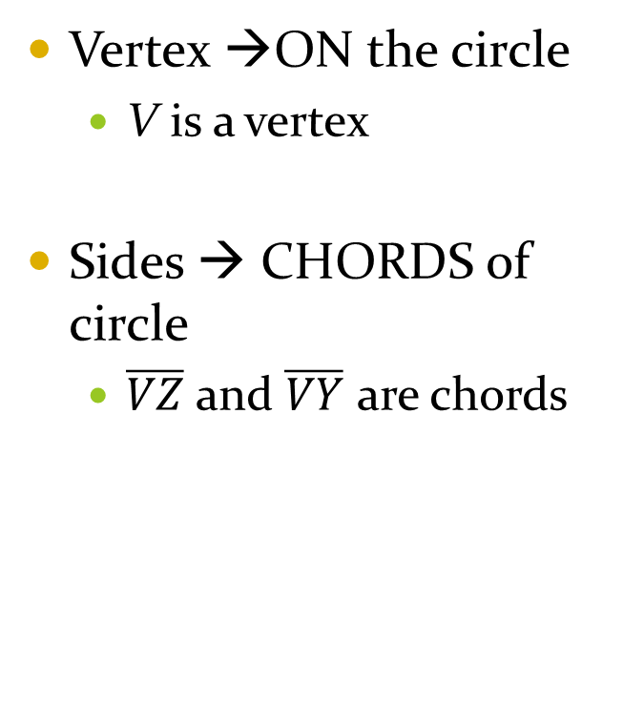
What is an inscribed ∠ ?
Vertex →ON the circle
  V is a vertex
Sides → CHORDS of circle
  $\overline{VZ}$ and $\overline{VY}$ are chords

Slide 3
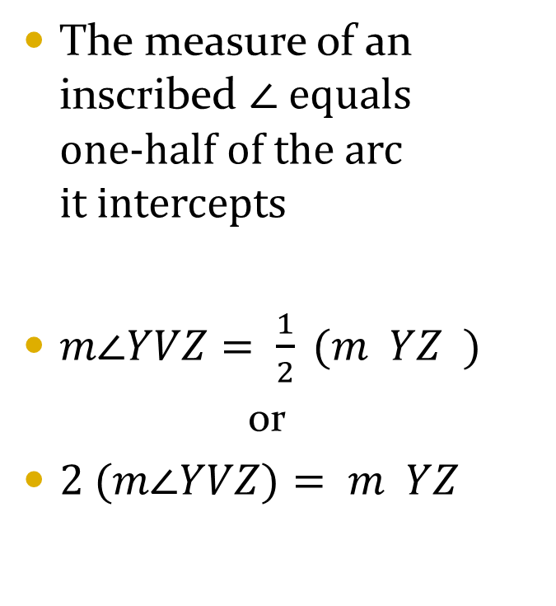
What is the size of an inscribed ∠ ?
The measure of an inscribed ∠ equals one-half of the arc it intercepts
$m∠YVZ= \frac{1}{2} (m YZ )$
  or
$2 (m∠YVZ)= m YZ$

Slide 4
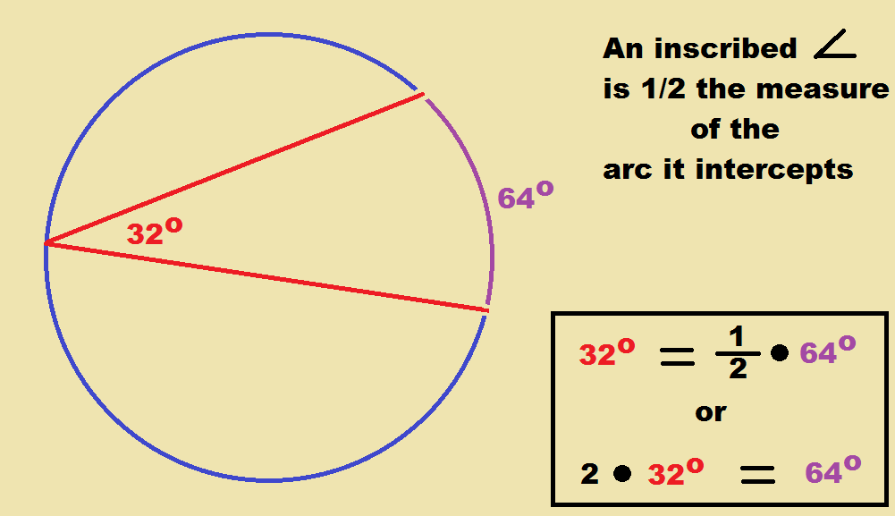
What is the size of an inscribed ∠ ?

Slide 5
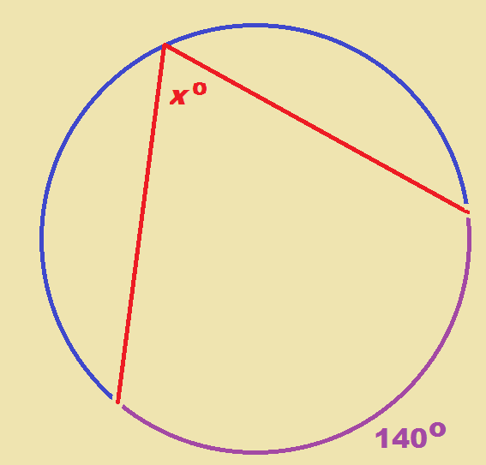

Example 1
What is $x$?

Slide 6

Example 1
What is $x$?
$$x= \frac{1}{2} \left(140\right)$$
$$x=70$$
Or
$$2x=140$$
$$x=70$$

Slide 7
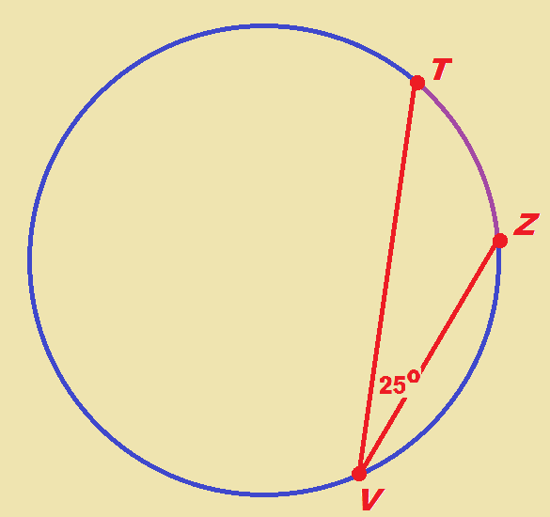

Example 2
What is $m TZ ?$

Slide 8

Example 2
What is $m TZ ?$
$2 •25= m TZ$
$$50°= m TZ$$

Slide 9
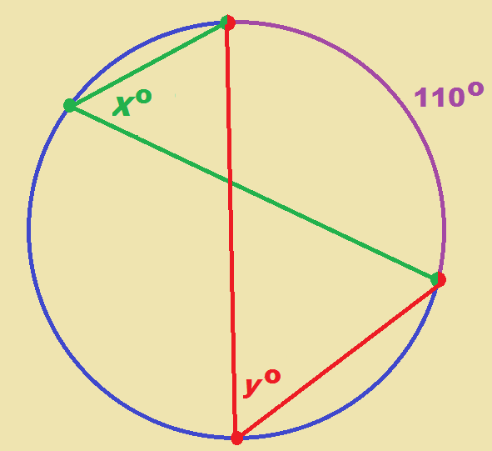
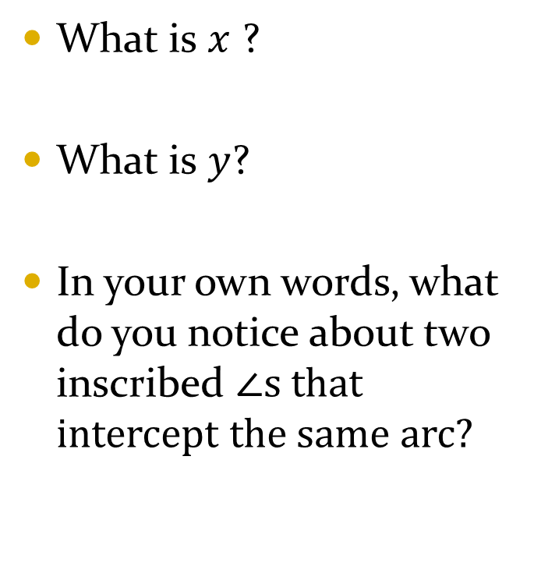
Two inscribed ∠s intercept same arc
What is $x$ ?
What is $y$?
In your own words, what do you notice about two inscribed ∠s that intercept the same arc?

Slide 10
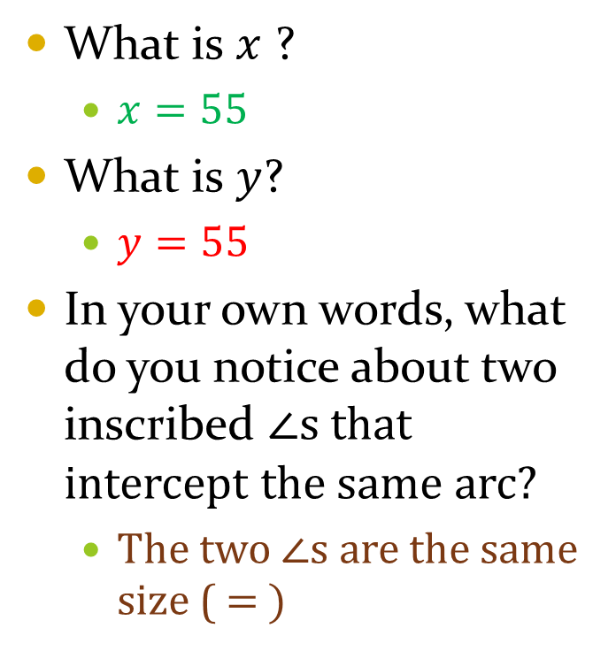
Two inscribed ∠s intercept same arc
What is $x$ ?
  $x=55$
What is $y$?
  $y=55$
In your own words, what do you notice about two inscribed ∠s that intercept the same arc?
  The two ∠s are the same size ($= )$

Slide 11
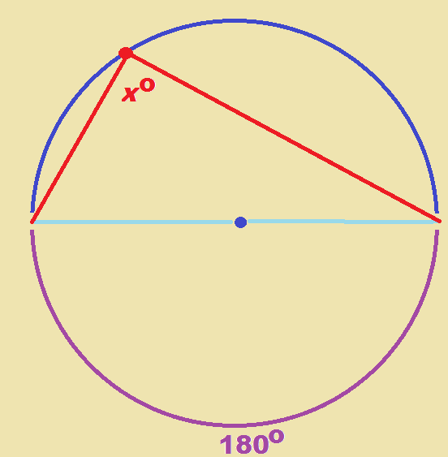
When an inscribed ∠ is inside a semicircle
What is x ?

Slide 12

When an inscribed ∠ is inside a semicircle
What is x ?
  $x=90$

Slide 13
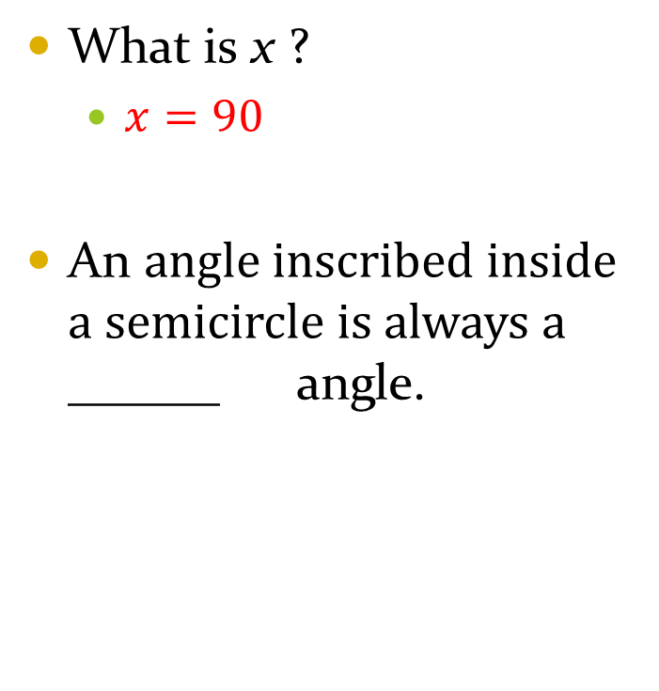
When an inscribed ∠ is inside a semicircle
What is x ?
  $x=90$
An angle inscribed inside a semicircle is always a ______ angle.

Slide 14
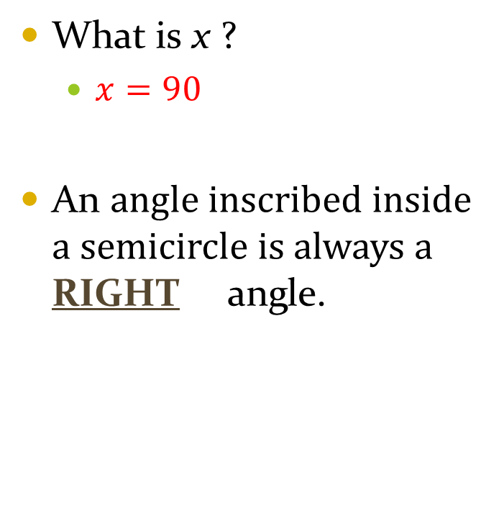
When an inscribed ∠ is inside a semicircle
What is x ?
  $x=90$
An angle inscribed inside a semicircle is always a RIGHT angle.

Slide 15
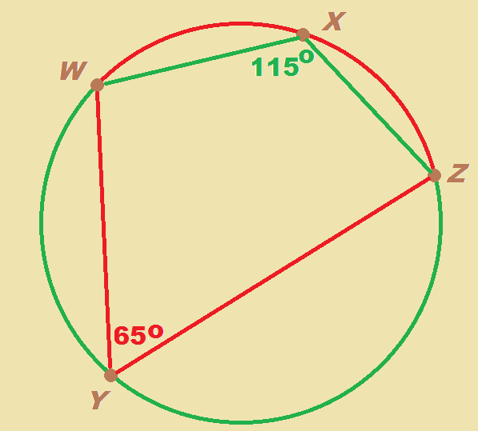

Quadrilateral inscribed inside a circle
What is $m WXZ ?$
What is $m WYZ$?

Slide 16
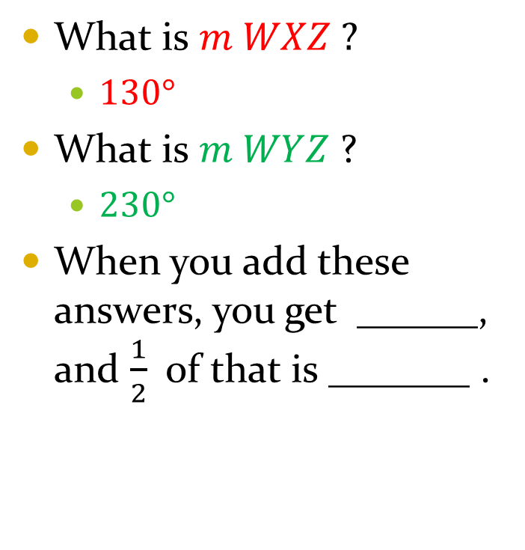
Quadrilateral inscribed inside a circle
What is $m WXZ ?$
  $130°$
What is $m WYZ$?
  $230°$
When you add these answers, you get ______, and $\frac{1}{2}$ of that is _______ .

Slide 17
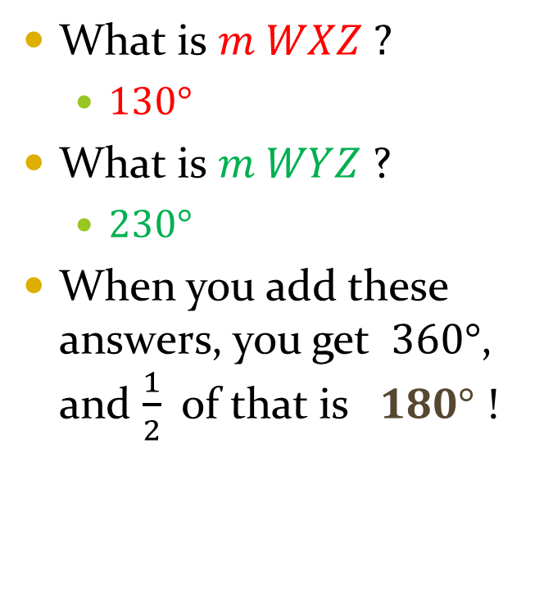
Quadrilateral inscribed inside a circle
What is $m WXZ ?$
  $130°$
What is $m WYZ$?
  $230°$
When you add these answers, you get $360°$, and $\frac{1}{2}$ of that is $180°$ !

Slide 18
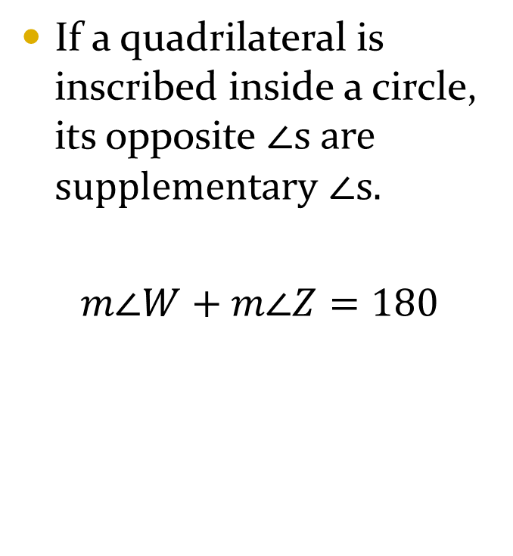
Quadrilateral inscribed inside a circle
If a quadrilateral is inscribed inside a circle, its opposite ∠s are supplementary ∠s.
$m∠W+m∠Z=180$

Slide 19
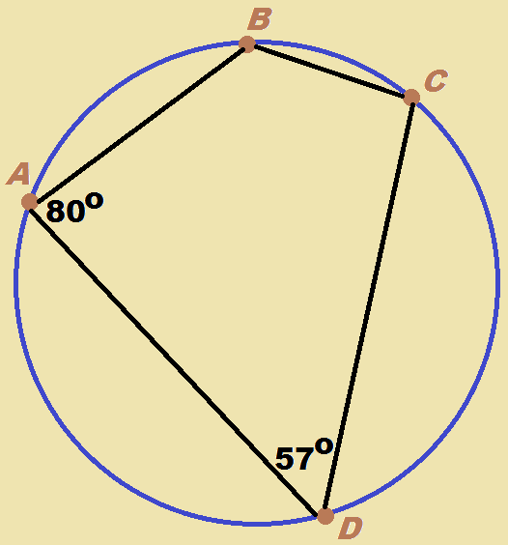

Example 5
What is $m∠B$ ?
What is $m∠C$ ?

Slide 20

Example 5
What is $m∠B$ ?
  $123°$
What is $m∠C$ ?
  $100°$

Slide 21
BowerPower.net

