Slide 1
Area of Rectangles & Squares
Geometry
Mr. Bower
BowerPower.net

Slide 2
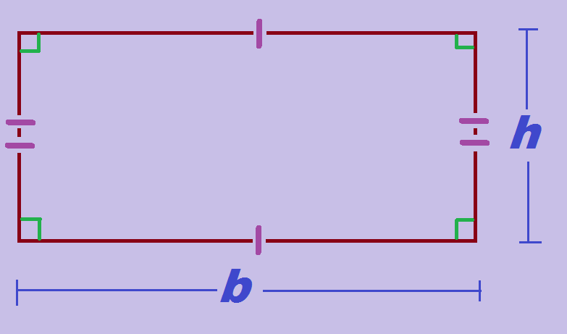

Rectangle - Perimeter
$Perimeter=2b+2h$
or
$Perimeter=2(b+h)$

Slide 3
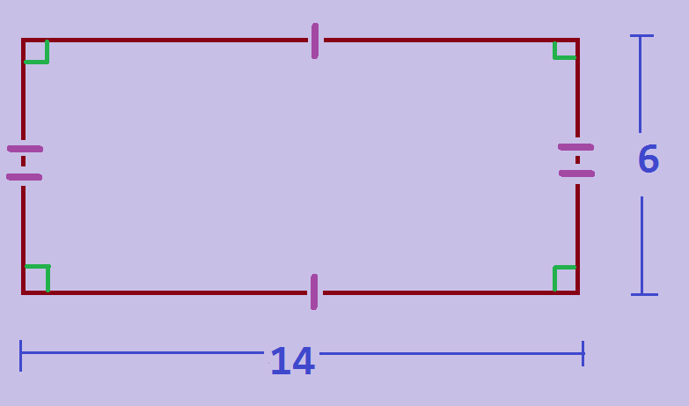

Rectangle - Perimeter
$Perimeter=2b+2h$
or
$Perimeter=2(b+h)$
What is the perimeter of this rectangle?

Slide 4

Rectangle - Perimeter
$Perimeter=2b+2h$
or
$Perimeter=2(b+h)$
What is the perimeter of this rectangle?
40

Slide 5

Rectangle - Area
$Area=b •h$

Slide 6

Rectangle - Area
$Area=b •h$
What is the area of this rectangle?

Slide 7

Rectangle - Area
$Area=b •h$
What is the area of this rectangle?
84

Slide 8
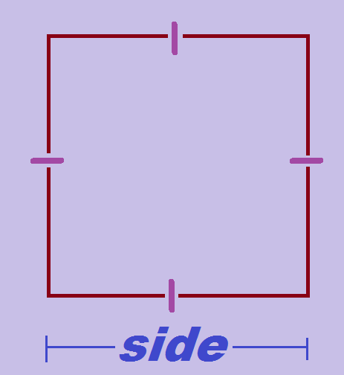

Square - Perimeter
$Perimeter=4 •side$

Slide 9
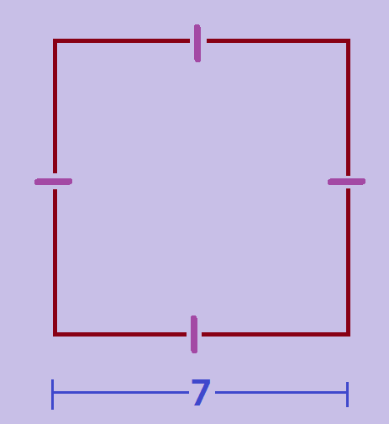

Square - Perimeter
$Perimeter=4 •side$
What is the perimeter of this square?

Slide 10

Square - Perimeter
$Perimeter=4 •side$
What is the perimeter of this square?
28

Slide 11

Square - Area
$Area={(side)}^{2}$

Slide 12

Square - Area
$Area={(side)}^{2}$
What is the area of this square?

Slide 13

Square - Area
$Area={(side)}^{2}$
What is the area of this square?
28

Slide 14
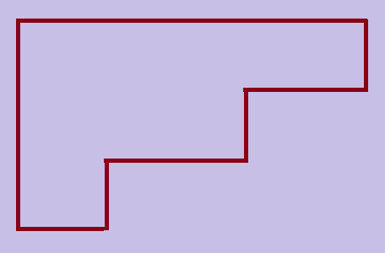
Area Addition
Area of entire shape
equals
the sum of the areas of all the parts of the shape

Slide 15
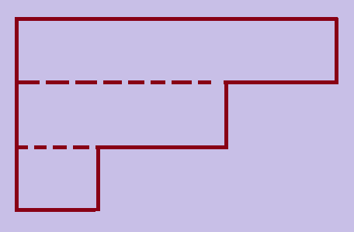
Area Addition
Area of entire shape
equals
the sum of the areas of all the parts of the shape
Let’s divide the shape into rectangular parts

Slide 16
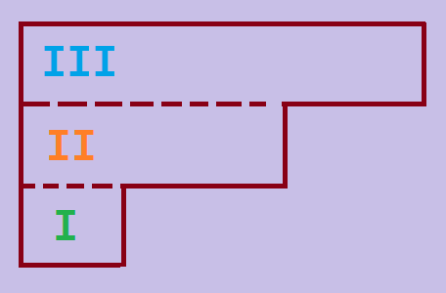
Area Addition
Area of entire shape
equals
the sum of the areas of all the parts of the shape
Let’s divide the shape into rectangular parts
(there are three rectangles)

Slide 17
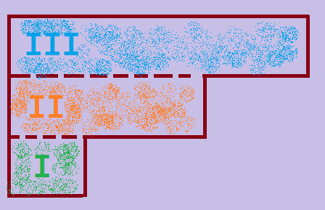

Area Addition
Area of entire shape
equals
the sum of the areas of all the parts of the shape
$$Area=Area of I+Area of II+Area of III$$

Slide 18

Summary
Rectangle
  $Perimeter = 2b + 2h$ or $Perimeter = 2(b+h)$
  $Area = b•h$
Square
  $Perimeter = 4•side$
  $Area = {(side)}^{2}$
Area Addition
  Total area = sum of individual parts

Slide 19
BowerPower.net

