Slide 1
Right Prisms
Geometry
Mr. Bower
BowerPower.net

Slide 2
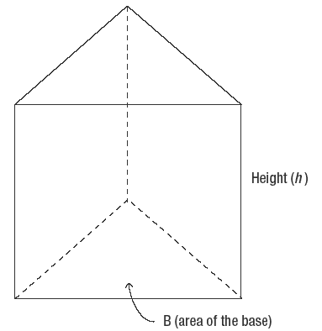
Example of a right prism
Here is an example of a triangular right prism
  Do you see the triangles at the top and the bottom?

Slide 3
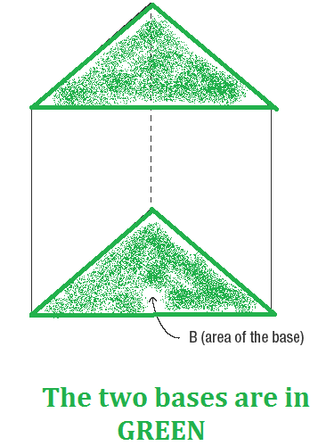
Parts of a right prism
Bases
  The bases are two congruent polygons
  The bases are parallel to each other
  The area of each base is represented with a capital B

Slide 4
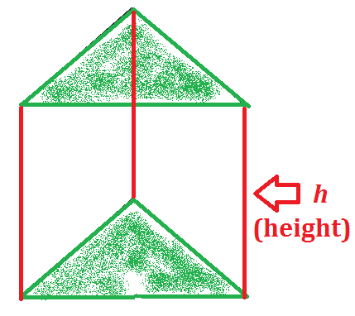
Parts of a right prism
Height (Altitude)
  Connects the two bases
  Perpendicular to both bases
  Every lateral edge is an altitude (height)
  The height is represented with the letter h

Slide 5
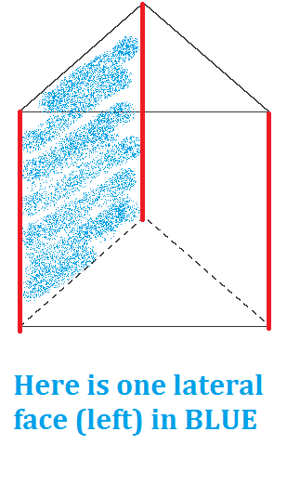
Parts of a right prism
Lateral Faces
  The lateral faces are rectangles
  Will be the “walls” if the prism is stood on one of its bases

Slide 6
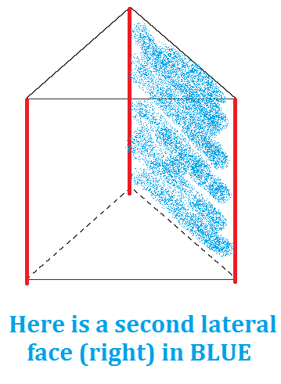
Parts of a right prism
Lateral Faces
  The lateral faces are rectangles
  Will be the “walls” if the prism is stood on one of its bases

Slide 7
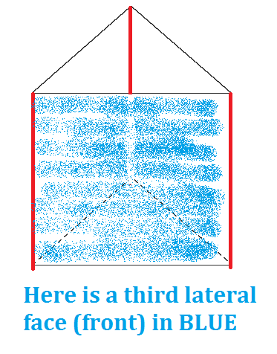
Parts of a right prism
Lateral Faces
  The lateral faces are rectangles
  Will be the “walls” if the prism is stood on one of its bases

Slide 8
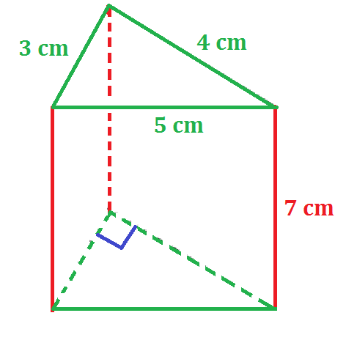
Lateral Area
The lateral area of a prism is the sum of the area of the lateral faces (the “walls”)
It is the area covered if you paint the “walls,” but not the “ceiling” or the “floor” (“ceiling” & “floor” are bases)

Slide 9
Lateral Area – Formula
L.A. = p • h
  p is the perimeter of a base
  h is the height of the prism

Slide 10

Lateral Area – Example
L.A. = p • h
$$p=3+4+5$$

Slide 11

Lateral Area – Example
L.A. = p • h
$$p=12$$

Slide 12

Lateral Area – Example
L.A. = p • h
$$p=12$$
$$h=7$$

Slide 13
Lateral Area – Example
L.A. = p • h
L.A. = 12 • 7

Slide 14

Lateral Area – Example
L.A. = p • h
L.A. = 84 ${cm}^{2}$

Slide 15
Surface Area
The surface area of a prism is the sum of the areas of all the faces (including both bases)
It is the area covered if you paint everything, including the ceiling and the floor

Slide 16
Surface Area – Formula
S.A. = L.A. + 2B
  L.A. is the lateral area of the prism (we already know it)
  B is the area of one base

Slide 17
Surface Area – Example
S.A. = L.A. + 2B
S.A. = 84 + 2B
We already know the L.A. – now let’s find the area of one of the bases

Slide 18
Surface Area – Example
S.A. = L.A. + 2B
S.A. = 84 + 2B
Each base is a triangle, so we’ll use
B = ½ • b • h

Slide 19
Surface Area – Example
S.A. = L.A. + 2B
S.A. = 84 + 2B
Each base is a RIGHT triangle, so
B = ½ • 3 • 4

Slide 20
Surface Area – Example
S.A. = L.A. + 2B
S.A. = 84 + 2B
Each base is a RIGHT triangle, so
B = 6

Slide 21
Surface Area – Example
S.A. = L.A. + 2B
S.A. = 84 + 2(6)

Slide 22
Surface Area – Example
S.A. = L.A. + 2B
S.A. = 84 + 12

Slide 23

Surface Area – Example
S.A. = L.A. + 2B
S.A. = 96 ${cm}^{2}$

Slide 24
Volume
The volume of a prism is the amount of space inside the shape
It is the amount of liquid you could pour into the shape

Slide 25
Volume – Formula
V = B • h
  B is the area of one base
  h is the height of the prism

Slide 26
Volume – Example
V = B • h
V = B • h
We already know both of these…
B = 6 and h = 7

Slide 27
Volume – Example
V = B • h
V = 6 • 7

Slide 28
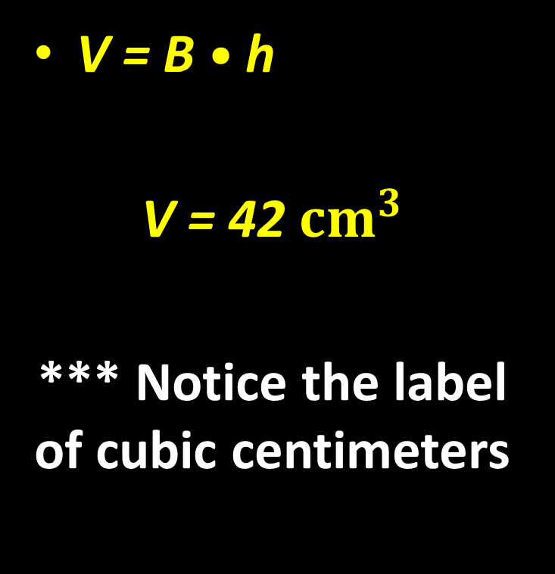
Volume – Example
V = B • h
V = 42 ${cm}^{3}$
*** Notice the label of cubic centimeters

Slide 29
Summary of Formulas
Lateral Area = ph
= (perimeter of base) • height
Surface Area = L.A. + 2B
= Lateral Area + 2 • (area of base)
Volume = Bh
= (area of base) • height

Slide 30
BowerPower.net

